Slide 1
Cleveland Neighborhood Association Zoom Call
August 24, 2020
6:30 -8:00 PM

Slide 2
Organization Summary
Cleveland Neighborhood Association works towards its mission by hosting regular events including youth events, monthly committee meetings engaging neighbors and city/county officials, and the popular Live On The Drive events, a summer concert and movie series that draws neighbors from nearby neighborhoods, and visitors from the Twin Cities region at large.

Slide 3
Mission Statement
Cleveland Neighborhood Association’s mission is to foster and cultivate a safe, diverse, and forward-thinking neighborhood by building relationships, inspiring community members and embracing local opportunity for the betterment of the lives of the residents of Cleveland Neighborhood.

Slide 4
Meeting Codes of Conduct
All members and guests must sign in by typing their email and name in the message box if they would like to participate in meeting
Please mute your connection if you are not speaking.
Guests will be given a set amount of time to speak on a motion. Comments will cease during a motion.
We will stick to the schedule, if there is something that needs further discussion past the time allowed for that line item it must be tabled until the end of the meeting during announcements.

Slide 5
Guests
MPD Community Liaison: Bill Magnusson
Policy Specialist, City of Minneapolis NCR: Steven Gallagher
Community Member: Ariah Fine

Slide 6
Attendance
Members: Chair Tommy Reyes
Vice Chair Kate Herman
Secretary Meredith Hyduke
Treasurer Patricia Crumely
Brenda Hasan
JoAnne Middaugh
Wesley Farrow
Armando Zentella-Ruiz
Cynthia Syverson
Matthew Jarolimek
Staff: Exec. Administrator Danecha Goins

Slide 7
Agenda
Call the meeting to order 6:30pm
Approval of May Minutes / 6:35pm
Treasurer and Financial Update
MPD Comm. Liaison & Community Safety 6:40pm
Executive Update 6:50pm
Live On The Drive Committee Postponed
Green Committee 7:00pm
Youth Committee Postponed
Cleveland Cares Postponed
Community Development 7:05pm
New Business/Board Discussion 7:35pm
Adjourn 8:00pm

Slide 8
Meeting Minutes Approval
Postponed until September Meeting
Agenda and April Meeting Approval: Motioned By- Seconded By-
Favor: Opposed: Abstention:

Slide 9
Financial Report
Approved
Current Agenda Approval: Motioned By- Seconded By-
Favor: Opposed: Abstention:

Slide 10
Executive Update
New Computer for CNA office
Audit Update
Office Upgrade
Volunteers to help clean
Board Members with terms ending

Slide 11
Community Safety
Surveillance Program
10 New request- April - Now
Cleveland Crime Map
MPD public website and create a GovDelivery account and then you would be able to receive them through your Email.
We Watch, We Call Signs-

Slide 12
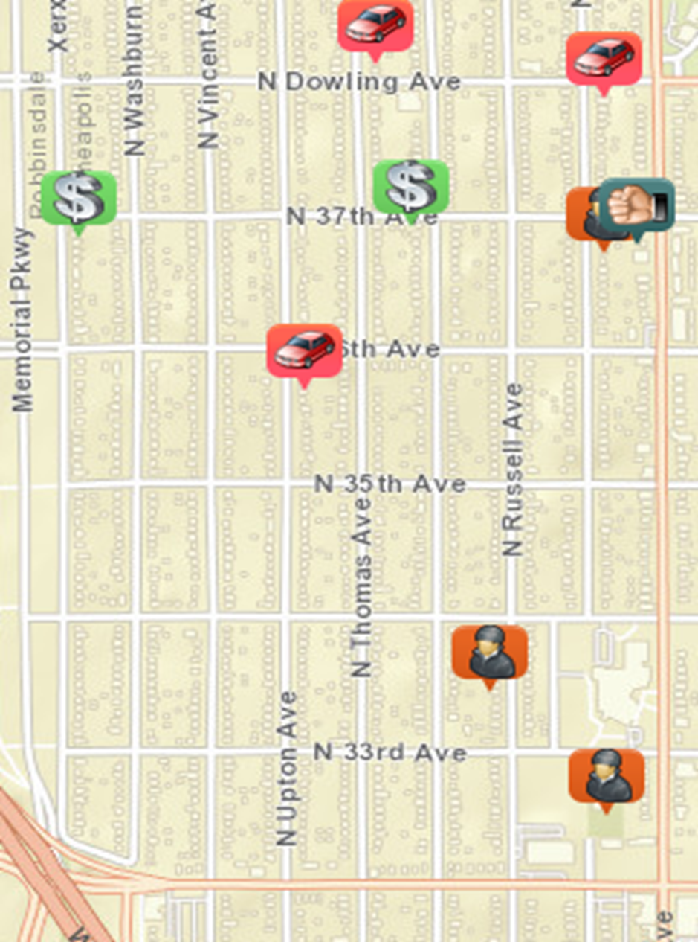
Community Safety
July 2020
Homicide: 0
Rape: 0
Robbery: 0
Assault: 1
Burglary: 3
Theft: 2
Auto Theft: 3
Larson: 0
TOTAL: 9

Slide 13
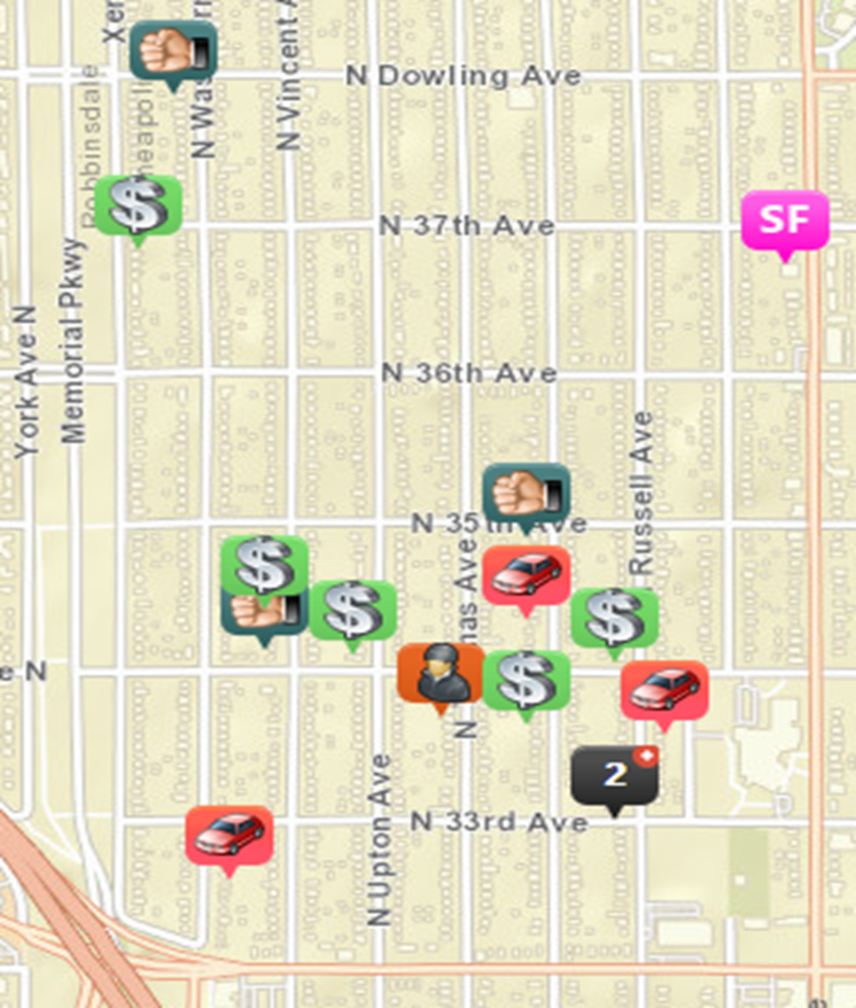
Community Safety
August 2020
Homicide: 0
Rape: 1
Robbery: 1
Assault: 3
Burglary: 2
Theft: 5
Auto Theft: 3
Larson: 0
TOTAL: 15

Slide 14
Community Safety
July 2020
Homicide: 0
Rape: 0
Robbery: 0
Assault: 1
Burglary: 3
Theft: 2
Auto Theft: 3
Larson: 0
TOTAL: 9
August 2020
Homicide: 0
Rape: 1
Robbery: 1
Assault: 3
Burglary: 2
Theft: 5
Auto Theft: 3
Larson: 0
TOTAL: 15

Slide 15
Community Development
2020 Focus Funding Letter
Penn & 35th Project Committee
Annual Party/ Elections
Census Update

Slide 16
Dear neighborhood leaders,
As many of you have seen first-hand, the COVID-19 pandemic and the civil unrest following the death of George Floyd have had a devastating and immediate impact on our local economy. These dual crises led to a major revenue shortfall for the City of Minneapolis of $160 million dollars, more than double any previous budget deficit. To address this shortfall, the City needed to make a mid-year budget adjustment like none other in our history, which impacted all municipal government operations, program funding and department budgets and included staff furloughs.
NCR was tasked with cutting 15% of our operating budget, while limiting the impact of these cuts on the community as much as possible. On July 24th, the Mayor and the City Council adopted a revised budget for the remainder of this fiscal year that included a $750,000 cut to neighborhood organization funding alongside cuts to the Neighborhood and Community Relations Department (NCR)’s operating budget, programs and grants.
In October, NCR will present more details regarding how these cuts will impact neighborhoods to the Neighborhood Revitalization Program (NRP) Policy Board. In reviewing where funds would be reduced, we have looked at both the 2020 CPP funds as well as NRP funds. Our concern was that if the cuts were made to the 2020 CPP funds, there would be an immediate impact on all neighborhood organizations by requiring you to make up the budget shortfall in less than 6 months. Thus, the reduction is coming from the NRP fund balance. Unlike CPP, there is a large balance in the NRP fund, and the impact of any cut can be spread out over a much longer timeframe.
While I realize this sounds like a large cut to funding, we are doing our best to mitigate its impact on any individual organization or community.
I appreciate your understanding, and please know that we will continue to do our best to support your organizations through these difficult times. If you have questions or concerns, please contact your neighborhood specialist.
Thank you,
David M Rubedor
Department Director/ADA Title II Coordinator
Pronouns*: he/him/his

Slide 17
35th and Penn Project
Board Action:
Approve a commitment of funds to the Northside Investment Cooperative Enterprise (NICE) to acquire 3445, 3449, and 3501 Penn. Including:
• Phase II NRP Lot Redevelopment Funds $145,833.28
• Phase III CPP Reserve Funds $10,000
• Phase I NRP Implement Lowry/Penn Strategic Plans $2,050.00
Direct CPED to work with NICE to contract the funds for the property acquisition to launch an investment cooperative focused on community ownership and local businesses.
Funding will be contingent on (include as many of these as you think would be important to the approval of the board):
• Additional funding being identified and approved for property acquisition
• Purchase agreement and closing on said property
• Supportive approval of project funding by 40 Cleveland residents by October 31st
• Expanded NICE board leadership to 6 members by Closing date
• Expanded NICE dues paying membership to 25 by Closing date
• Commitment from community partners to be identified, such as City of Lakes Community Land Trust or Twin Cities Land Bank
• With final contingencies to be specified within 30 days
• To determine clarification if board members also be investors
Decisions regarding funding:
• Up to $155,000 no-interest 5-year forgivable loan contingent on expanding membership to 200 members
• All funding contingent on Penn Properties remaining in possession of NICE MN for the intended uses for 15 years
All of this goes to CPED to actually finalize all the agreements and contingent on their own legal and development due diligence.

Slide 18
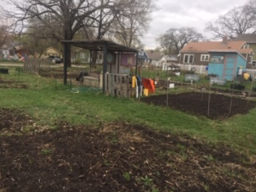
Green[ing]
Community Garden
Litter Be Gone

Slide 19
New Business
What you got Cleveland?!

